Slide 1



VULCAN BAG
Teja Vamsi | NAVNEET | AKSHAY | PRANAV

Slide 2






PROBLEM
Market gap
Food delivery professionals need a reliable solution to maintain the optimal temperature of hot food during transportation but are using conventional, inefficient methods.
Design
Current bags aren’t durable and light-weight. Couldn’t use for longer time and have no advanced heating features
Costs
Inadequate temperature maintenance can lead to customer complaints and loss of business opportunities for food delivery services.
usability
Delivery professionals want a user-friendly and efficient hot food delivery bag that simplifies their delivery process and ensures food quality.

Slide 3





Solution
Close the gap
VULCAN is the best solution for maintaining the optimal temperature of hot food during delivery, offering unique features that no other hot food delivery bag on the market provides.
Target audience
Delivery Executives, Food Delivery Companies, and Restaurants
CONSUMER SATISFACTION
A 15% increase in customer retention and satisfaction for food delivery companies that adopt VULCAN hot food delivery bags.
Easy to use
VULCAN's electric heating capacity keeps food warm throughout the delivery process, ensuring ease of use for executives, while its durable yet lightweight structure enhances usability and convenience.

Slide 4




PROGRESS
PRODUCT DEVELOPMENT
Conducted extensive market research to identify customer pain points and preferences.
Collaborated with experts , finalized the design and manufacturing process.
PROTOTYPE TESTING
Gathered user feedback on VULCAN prototype design, including comfort and weight.
Conducted various trials to ensure consistent temperature maintenance .
CUSTOMER FEEDBACK
Conducted surveys and interviews with executives and end-consumers to gather valuable insights.
Incorporated and improved based on user feedback to make it more comfortable.

Slide 5

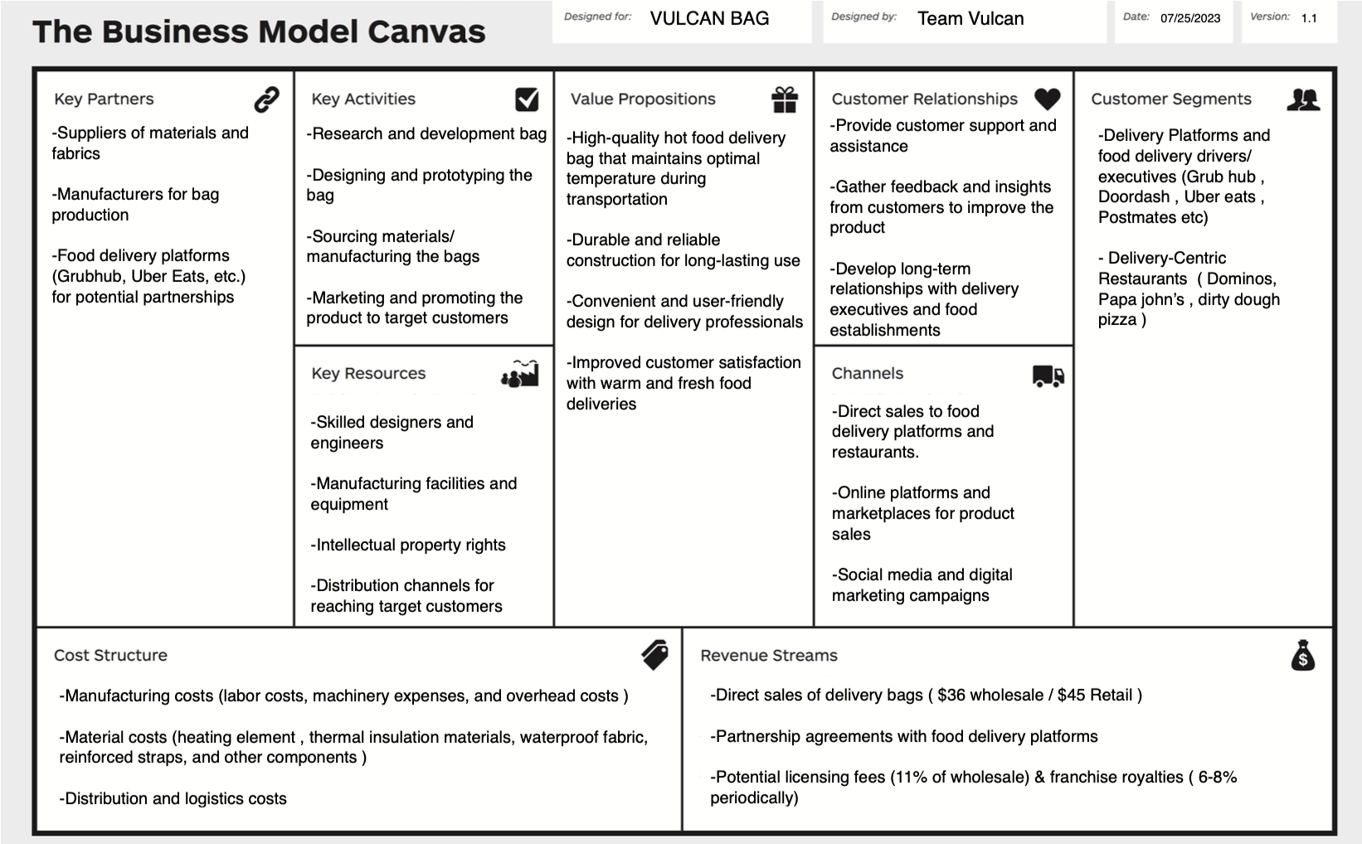
THE BUSINESS MODEL CANVAS

Slide 6
MARKET SIZE OF VULCAN
Total Addressable Market (TAM)
$18B
Food delivery bags industry size worldwide : 18 Billion USD
Serviceable Addressable Market (SAM)
$5.4B
The US market size for insulated food delivery bags : 5.4 Billion USD
Service Obtainable Market (SOM)
$63M
Aims to achieve ~1% market penetration : 63 Million USD

Slide 7
FINANCIAL PROJECTION
ESTIMATED KEY-METRICS
**VULCAN BAG REATIL PRICE = $45 // WHOLESALE PRICE = $36
 | Orders | Cost of Goods Sold | Gross revenue | Gross Profit | Operating Expenses | Net revenue | Net ​ Profit Margin For Wholesale​ | Net ​ Profit Margin For Retail​
 |  |  |  |  |  |  | ​ | ​
2023 | 15,000 | $371,250 | $675,000 | $303,750 | $100,000 | $203,750 | $270,000 (40.0%) | $16,875 (2.5%)
2024 | 27,000 | $668,250 | $1,215,000 | $546,750 | $150,000 | $396,750 | $486,000 (40.0%) | $136,687 (11.2%)
2025 | 45,000 | $1,113,750 | $2,025,000 | $911,250 | $200,000 | $711,250 | $800,000 (44.0%) | $227,812 (25.0%)
2026 | 63,000 | $1,559,250 | $2,835,000 | $1,275,750 | $250,000 | $1,025,750 | $1,134,000 (44.0%) | $318,937 (25.0%)
2027 | 80,000 | $1,980,000 | $3,600,000 | $1,620,000 | $300,000 | $1,320,000 | $1,440,000 (40.0%) | $405,000 (30.7%)

Slide 8
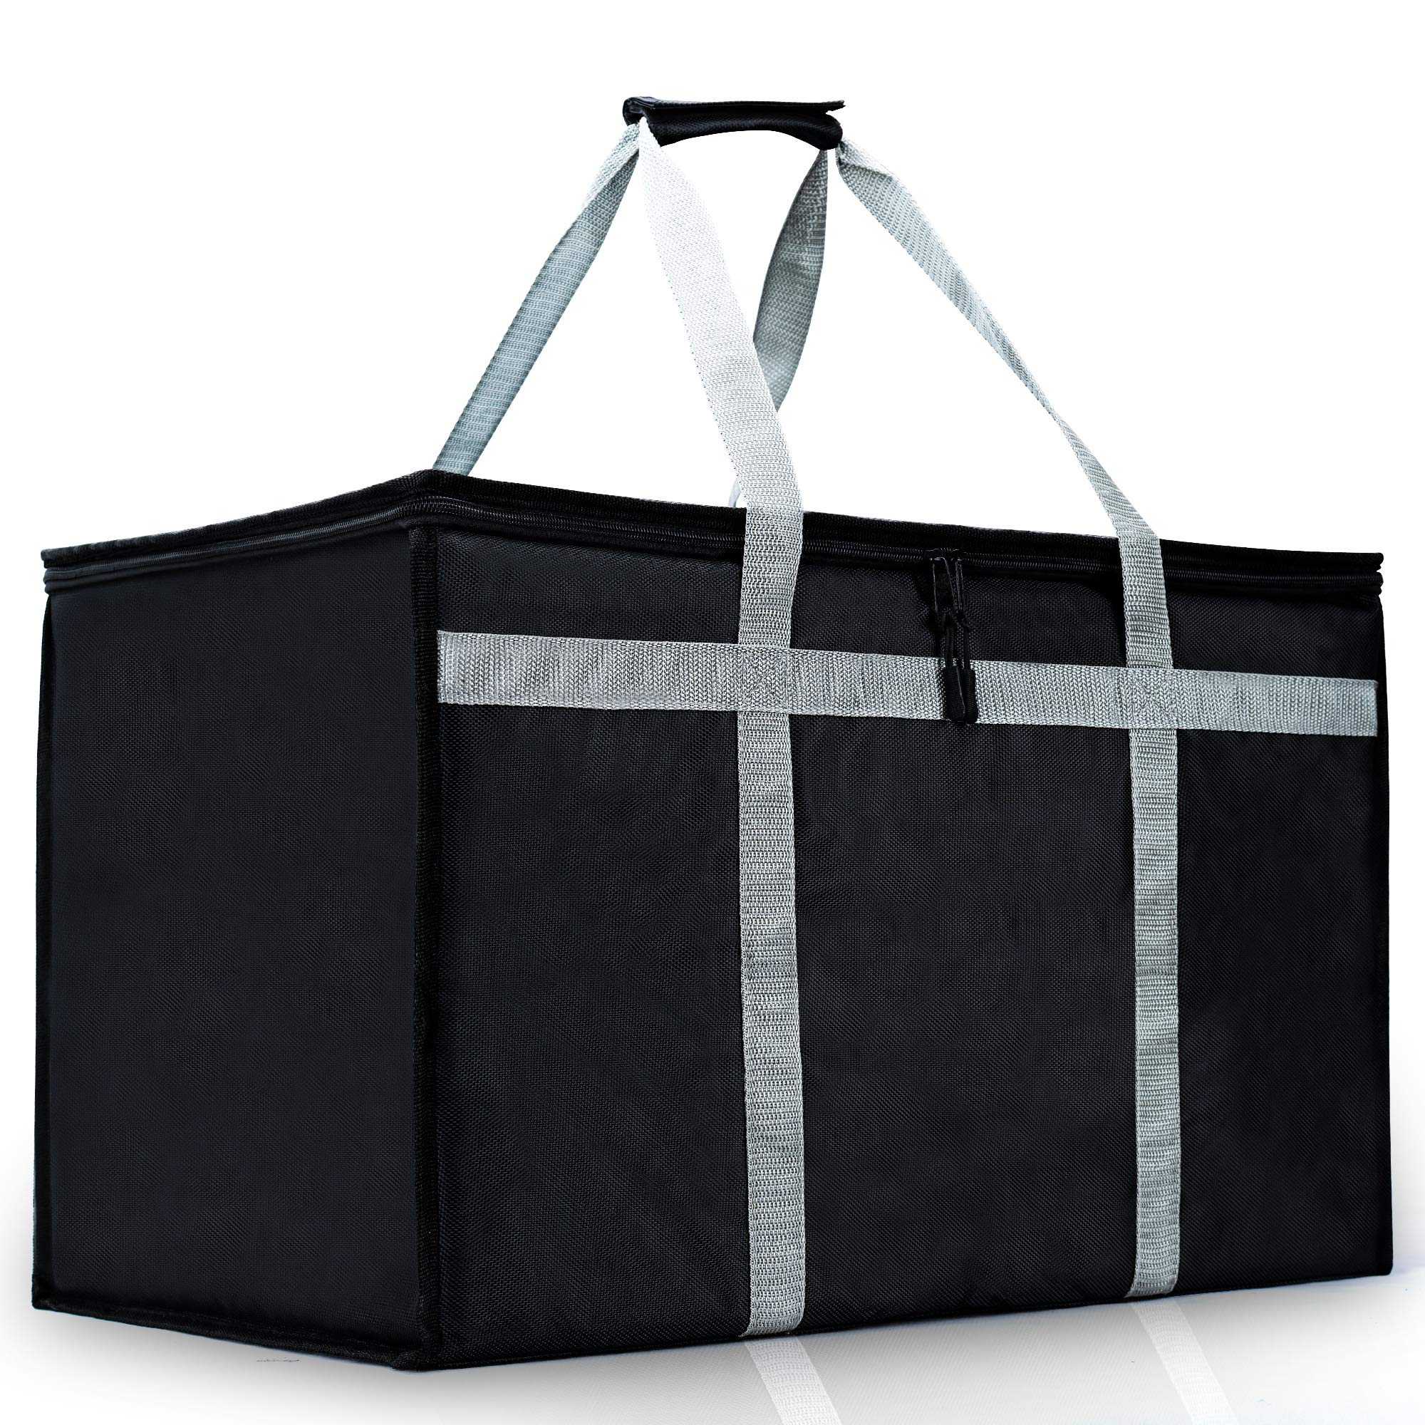
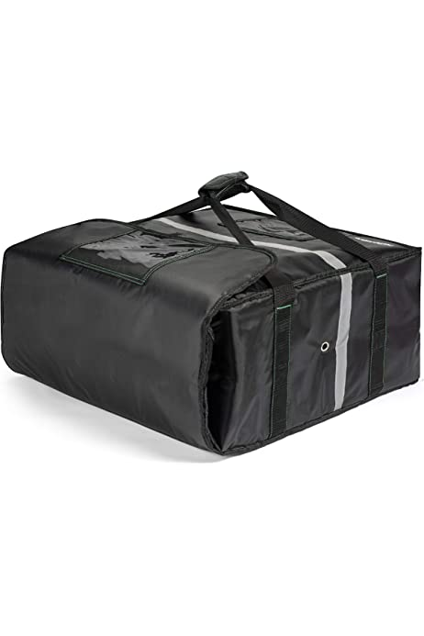
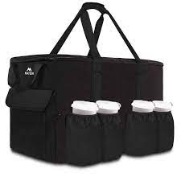
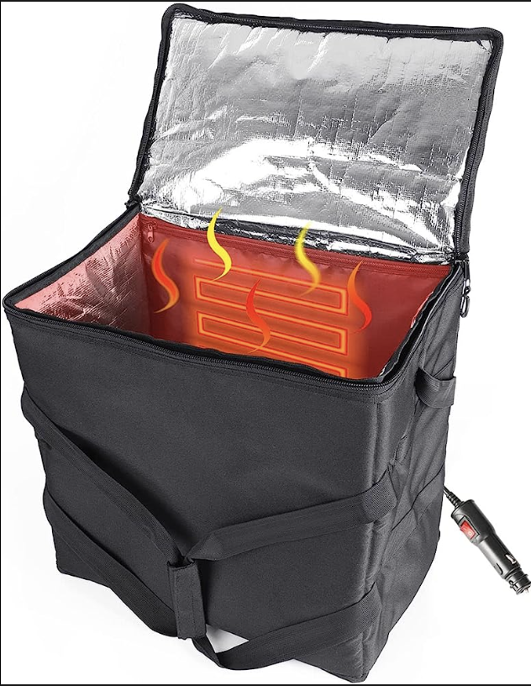

COMPETITION ANALYSIS
TRAITS | BODAON DELIVERY BAG | CARLISLE FOOD PAN CARRIER | MATEIN DELIVERY BAG | VULCAN BAG
HEATING CAPACITY
DURABILITY
EASE OF USE
PORTABILITY
ELECTRIC - POWERED
SUSTAINABILITY

Slide 9
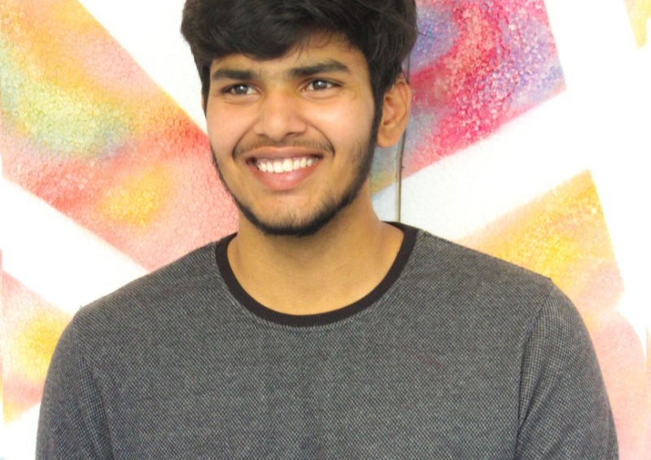
MEET THE TEAM
TEJA VAMSI
AKshay
navneet
pranav
CEO (Chief Executive Officer) Overall strategic vision and leadership for the company
CTO (Chief Technology Officer) Leading the R&D efforts for the heating elements and temperature control features
Head of Design Leading the design team to create an aesthetically appealing and user-friendly product
Product Manager Managing the product development process from concept to launch

Slide 10
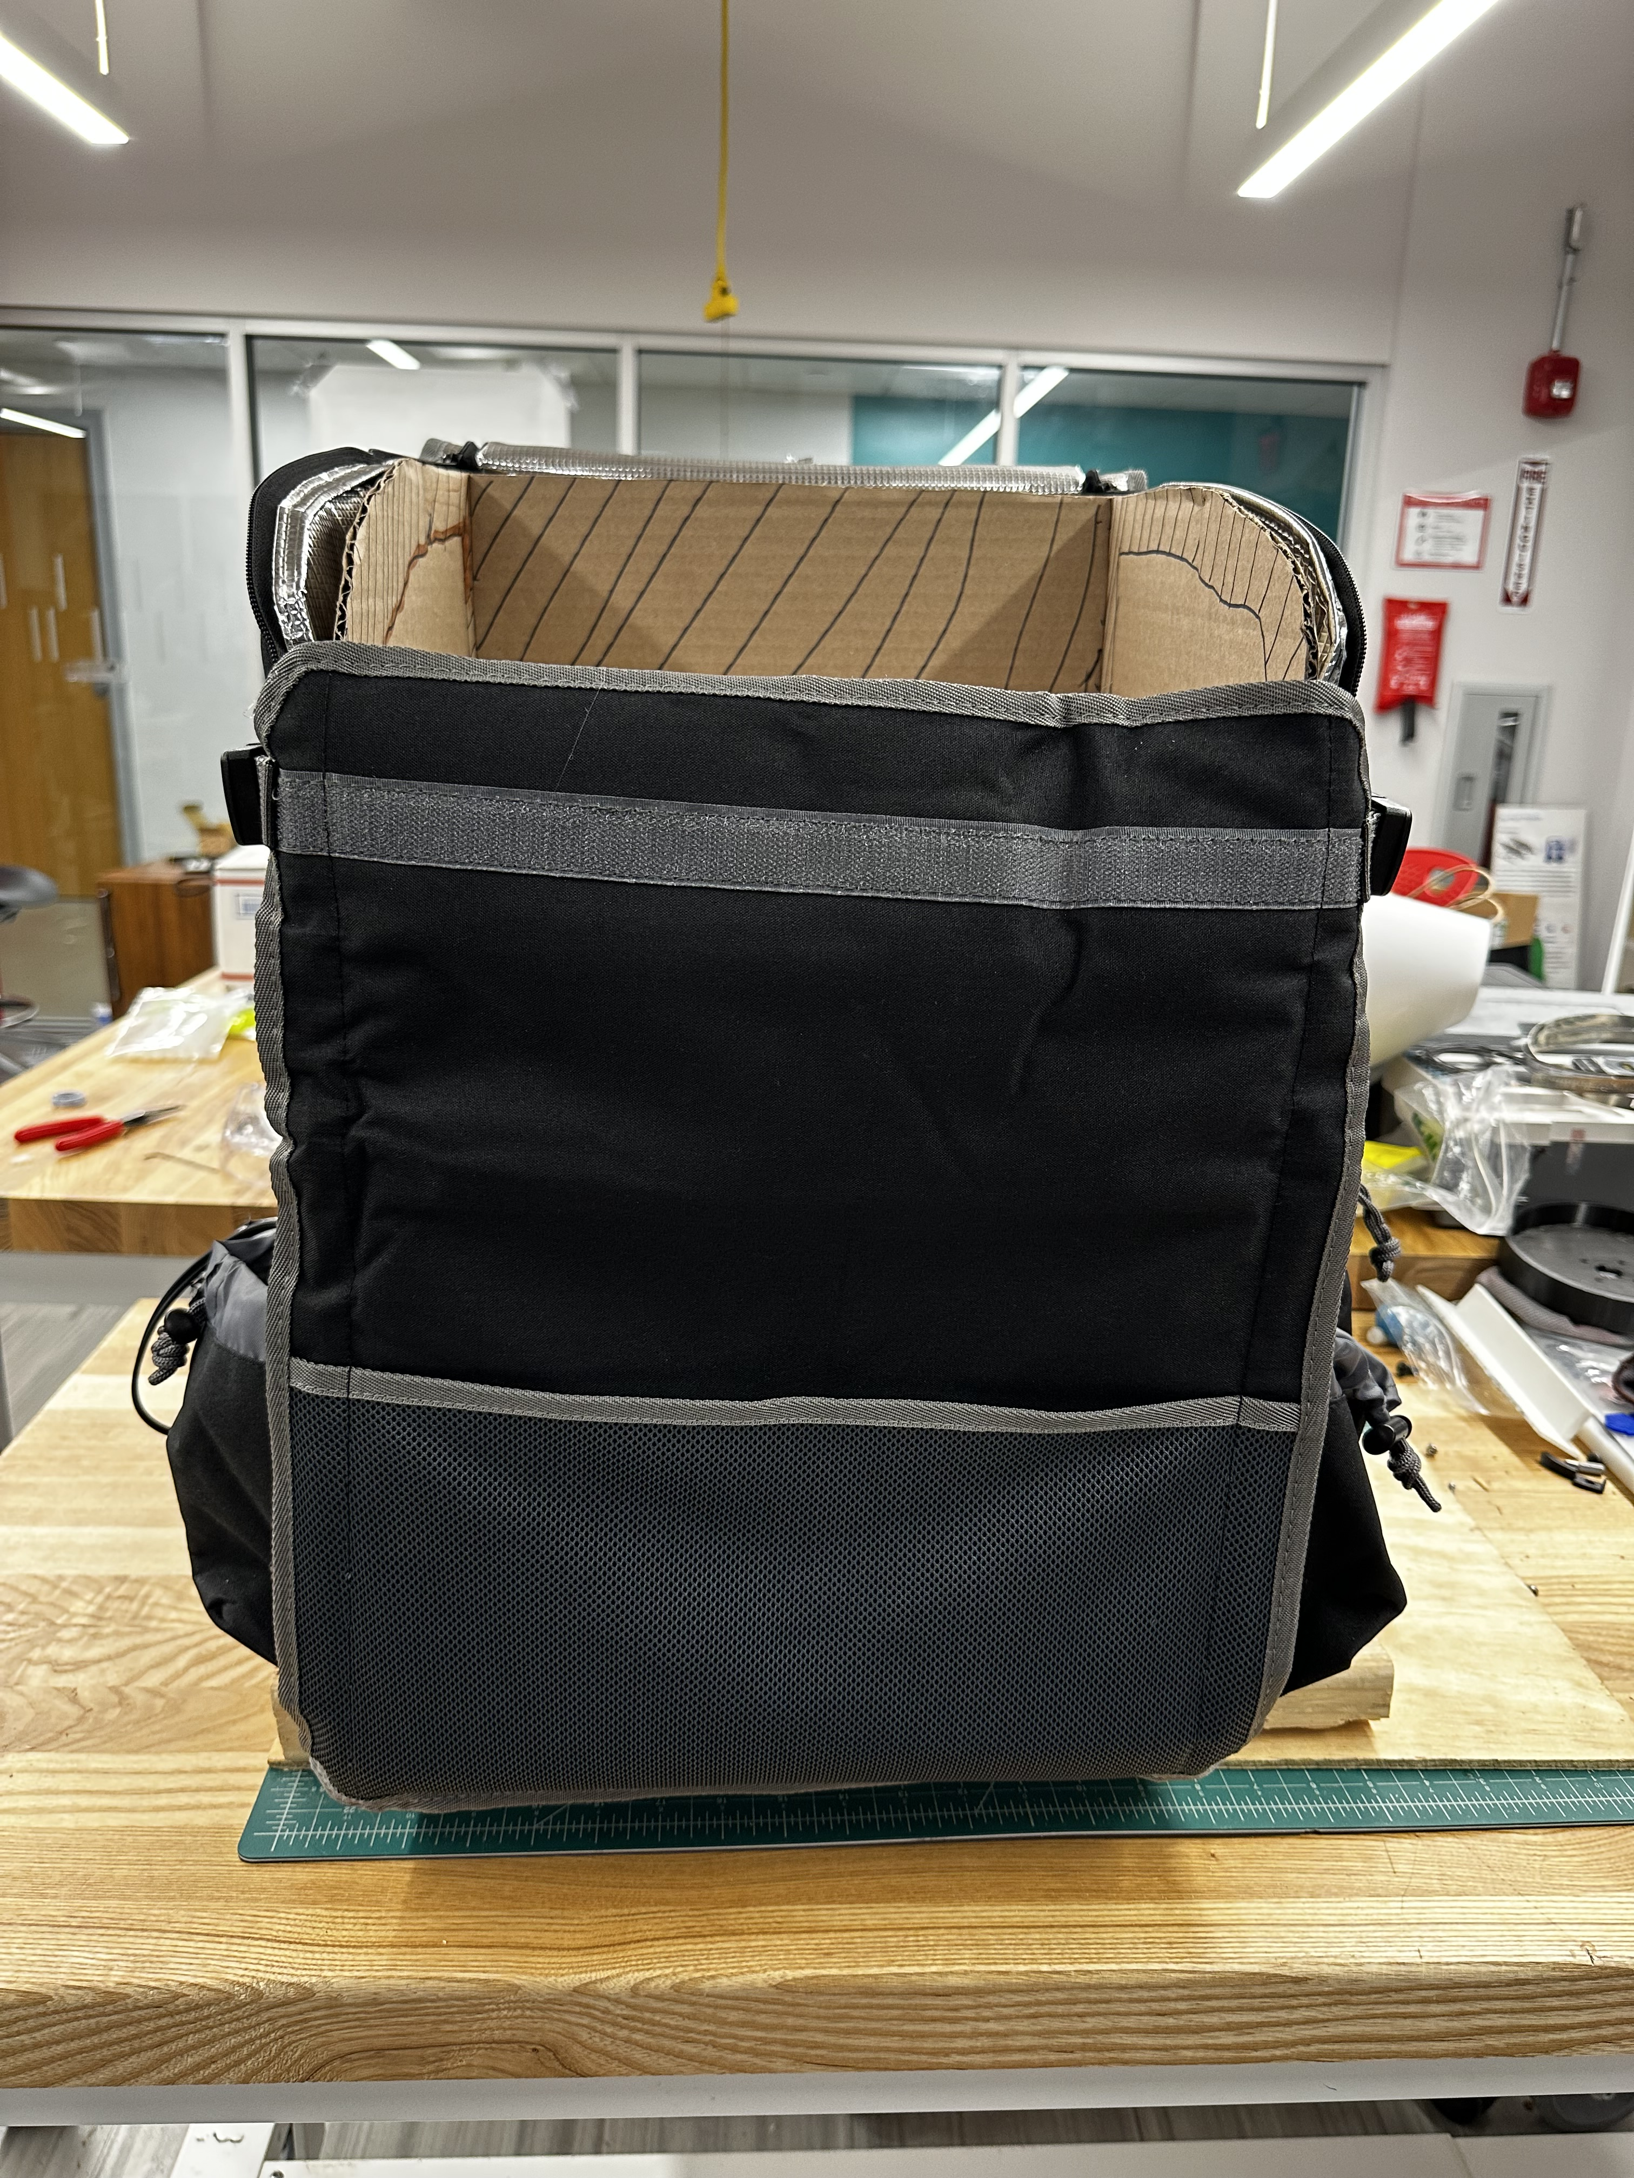
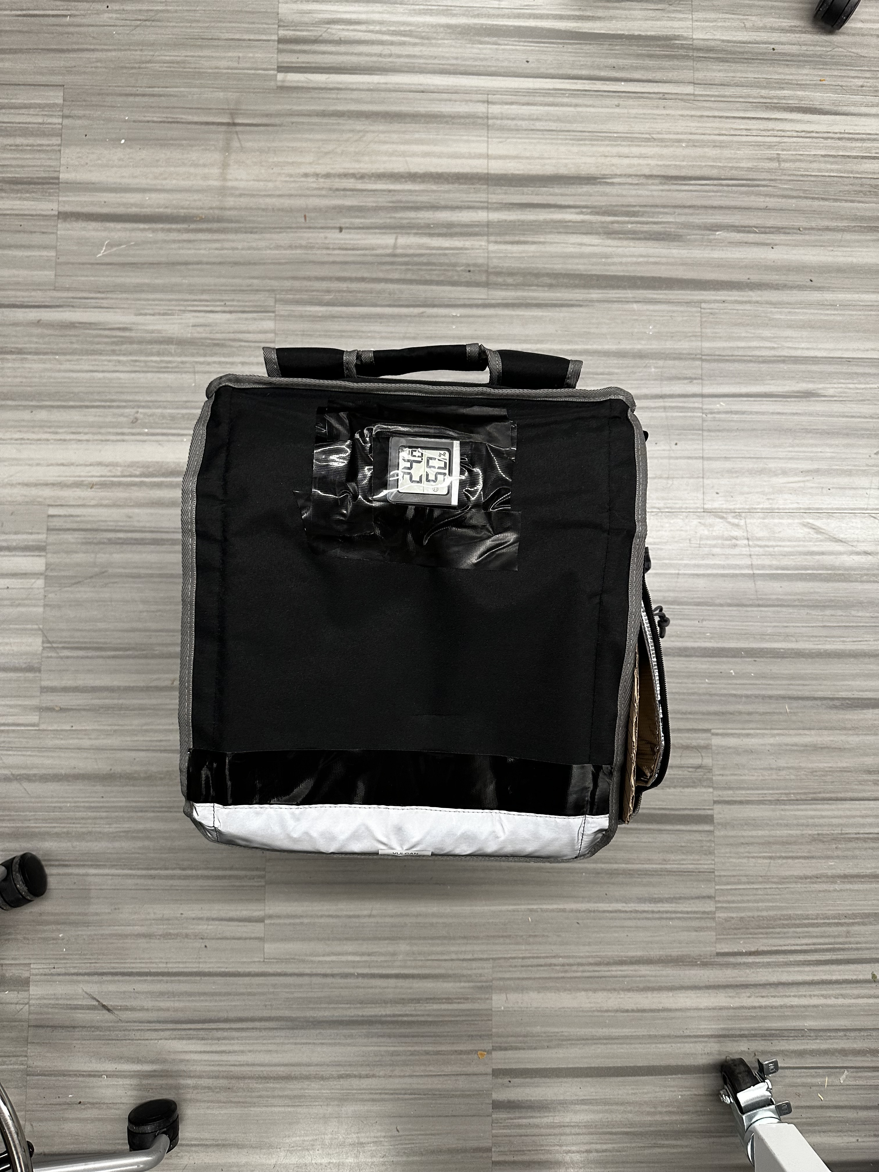
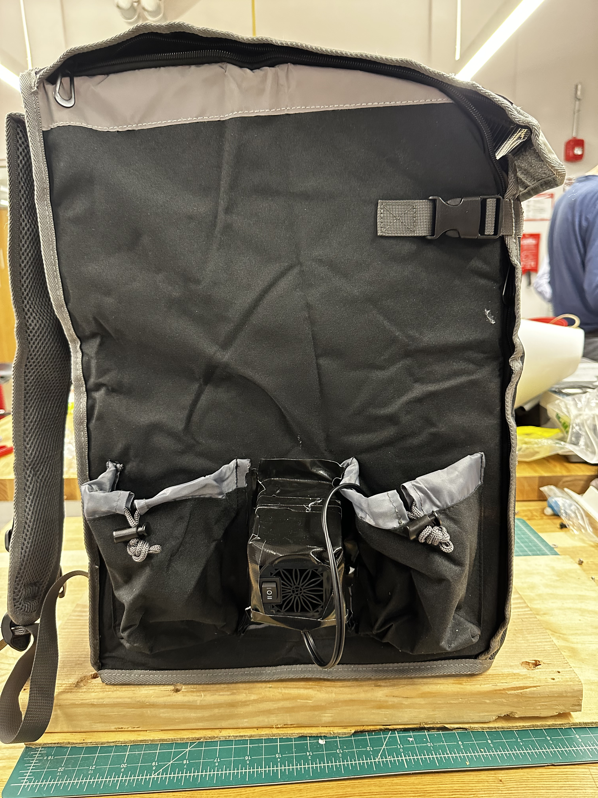
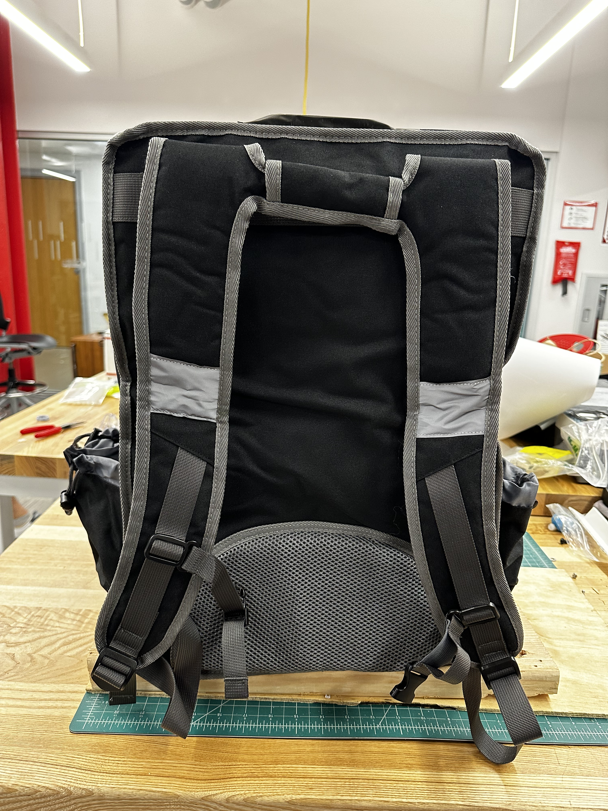
VULCAN PROTOTYPE

Slide 11
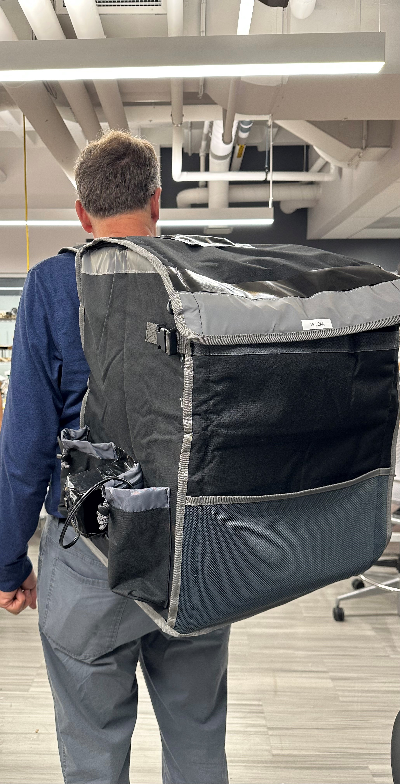
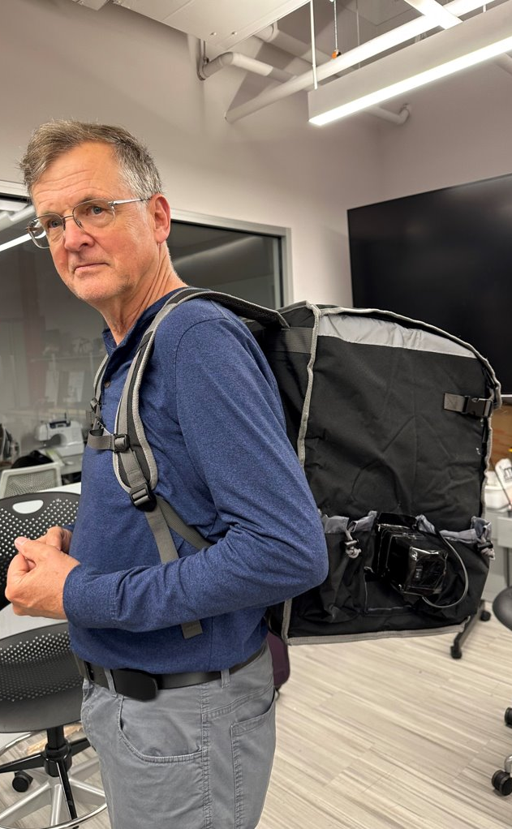
SUMMARY
VULCAN makes food delivery better ! Our hot food delivery bag keeps your food hot and tasty, ensuring happy customers every time.
We're committed to constant improvement and innovation, so you can trust that you're getting the best.
Partner with us to elevate your food delivery game and make your customers incredibly happy.

Slide 12

THANK YOU

